Slide 1
Startup: Success or Failure?
Namha Adukia- Sahil Arora- Muskan Jain- Shazlie Khan- Gary Huy Nyugen

Slide 2

Value Proposition
Helping Venture Capitalists improve accuracy of their investments by understanding whether a start up will be successful
(Raising minimum Series B funding)

Slide 3
Our Approach
Business Requirement
Predict the potential success of a startup founder to improve VC’s investment accuracy
Evaluation and
Interpretation
Data Acquisition
Accuracy, Precision, Recall, MSE, F1-Score
Crunchbase Data (Companies + Founder + Investments)
Modelling
Data Preparation
Random Forest, SVM,
XGBoost and others
Extracting data on education from biographies, extracting headquarter location, etc
Feature Engineering
Feature Selection
Creation of dummy variables

Slide 4
Data Extraction
Data was extracted from Crunch base and GitHub
There were 3 primary data files that had information on:
Companies (Industry, Headquarters, Founded Date, Company Type)
Founders (Biography, Gender, Number of Founded Organizations, Number of Portfolio Companies)
Investments (Funding Type, Funding Date, Funding Amount)

Slide 5
Data Manipulation
Extraction of Data on Education
Extract education by merging on Founder Name from Crunchbase website.
Extract data on whether founder attended ivy league college using bio column
For example, ‘Sergey Sundukovskiy, Ph.D. has over 20 years of experience serving…’ would give a 1 value for Ph.D.

Slide 6
Feature Engineering
Dummy on Masters, PhD
Bachelors is the base case
Creation of headquarters feature
We replaced the headquarter column which was in the format of ‘City, State, Country’ with the frequency of occurrence of that location.
Dummy on Ivy League + Stanford + MIT + Caltech
Dummy on industry
The main 11 categories are Tech, Finance, Healthcare, Logistics, Real Estate, Retail, Lifestyle and Fashion, Travel and Hospitality, Energy/Environment, Media and Marketing and Other

Slide 7
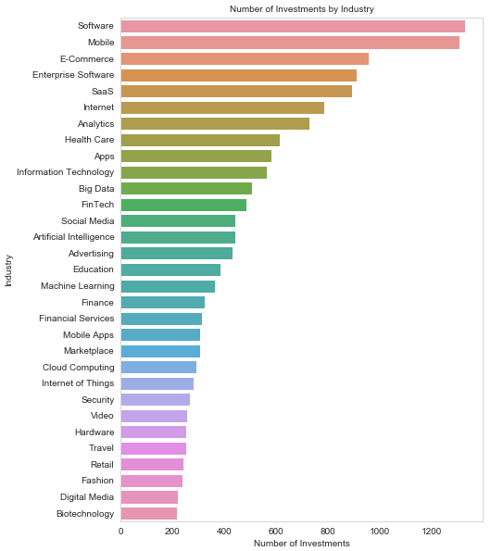
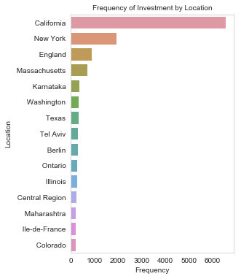
Data Visualisation
Notes:
Possibly due to the open-sourced nature of CrunchBase, the company market presents a considerable degree of variability, with 520 different markets. Here are the top 30 invested ones

Slide 8
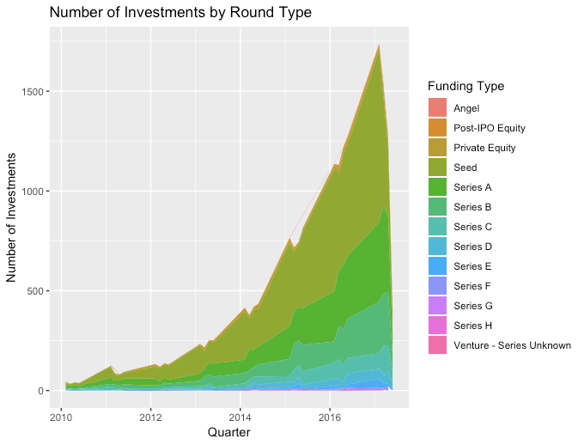
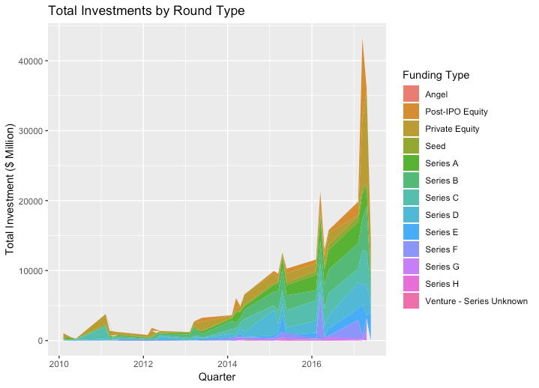
Investments by Round

Slide 9
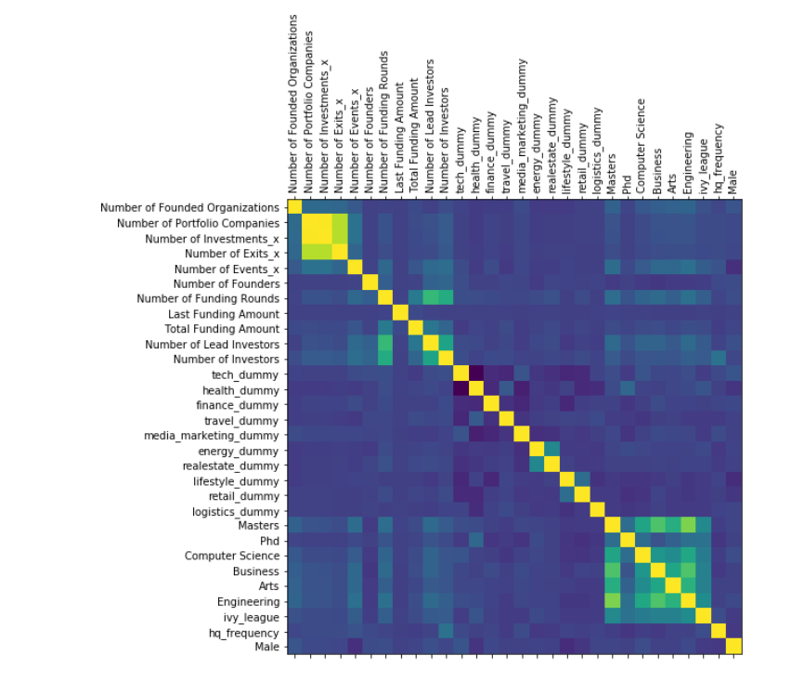
Correlation Matrix
After analyzing the correlation matrix, we dropped highly correlated features such as:
Number of lead investments
Number of partner investments
Last equity funding amount
Total equity funding amount
other dummy
bachelor dummy

Slide 10
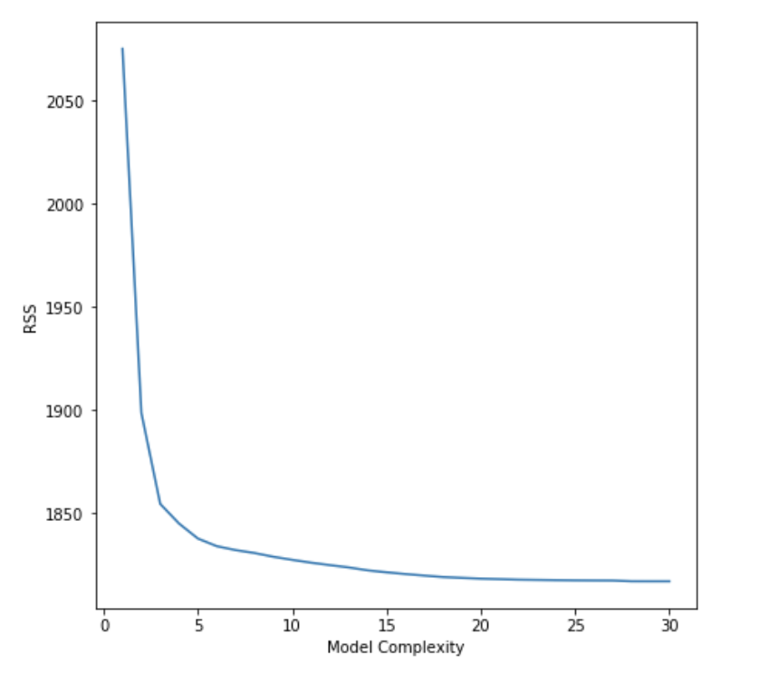
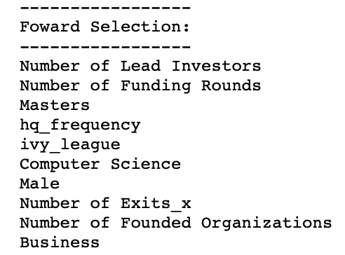
Forward Stepwise Selection
Forward stepwise selection: We ran forward stepwise selection on all the features, and plotted the minimum RSS of each model containing (1… 30 ) number of features. We chose the n that minimised the RSS. The final number of features are and 8 features chosen are:

Slide 11
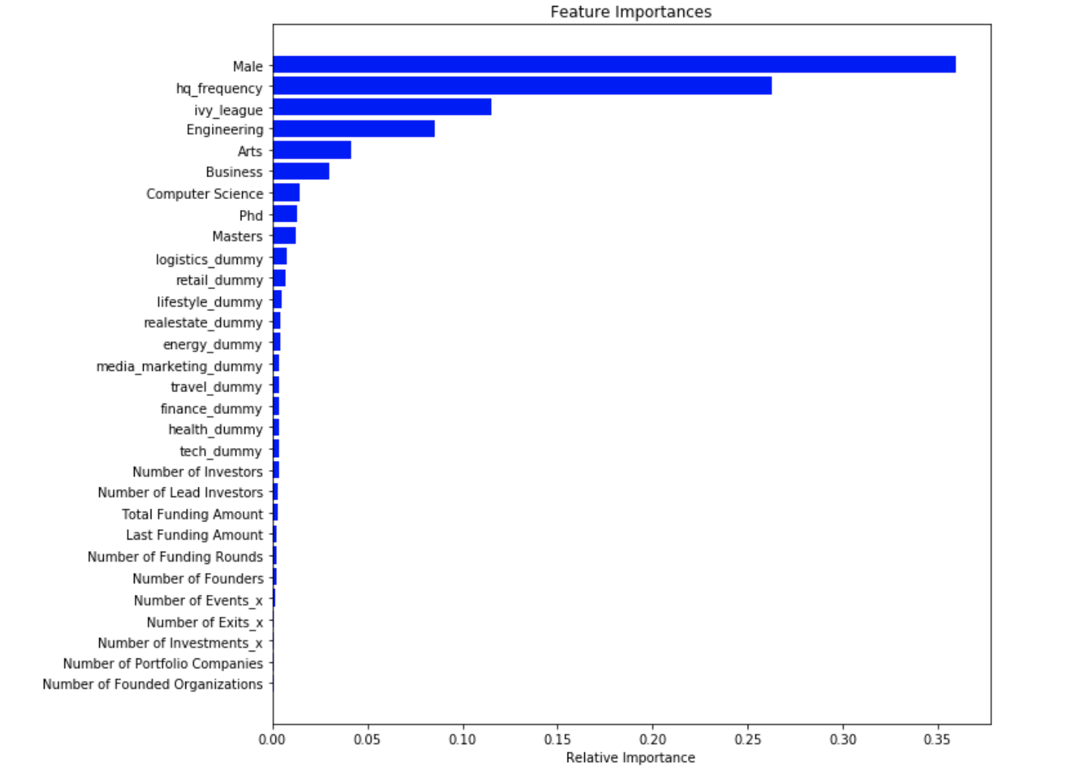
Random Forest
We divided the model into 75-25% train test and ran random forest on it, using all the features in the dataset except target variable. We performed a Grid Search Cross Validation on the model, and got the the best score and the best parameters.

Slide 12
XGBoost
XGBoost is an implementation of gradient boosted decision trees designed for speed and performance.
The best scores and parameters obtained through this model are as follows

Slide 13
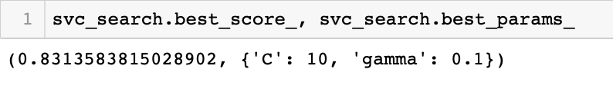
SVC
A Support Vector Classifier (SVC) is a discriminative classifier formally defined by a separating hyperplane. Given labeled training data (supervised learning), the algorithm outputs an optimal hyperplane which categorizes new examples.
We used the cross validation grid search to find out the hyper parameters. The best kernel coefficient is 0.1 and best penalty parameter C is 10.
The accuracy of our SVC on training set is 84.96%

Slide 14
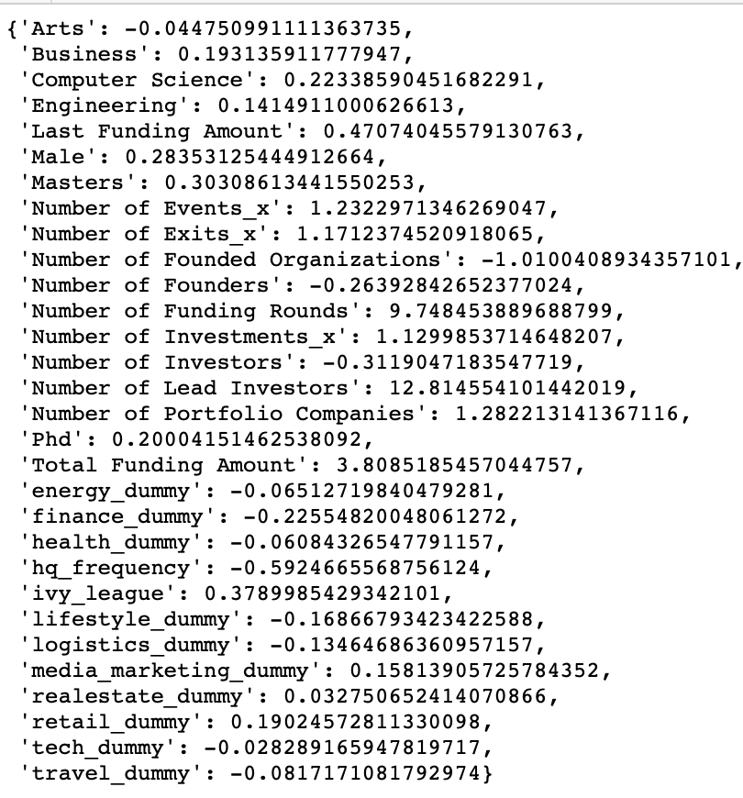
Logistic Regression
The coefficients for Logistic Regression are as shown
Business, Computer Science and Engineering have a positive coefficient whereas Arts has a negative coefficient showing founders having CS, Eng, Business degrees succeed
All the results are intuitive, except for tech_dummy, number of investors and Headquarter frequency which have a negative coefficient.

Slide 15
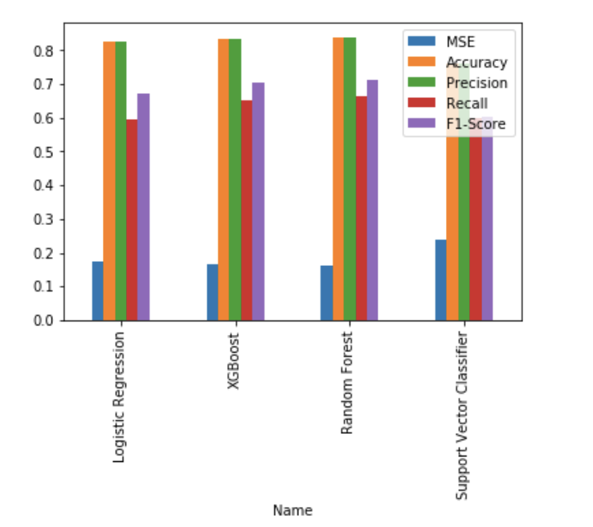
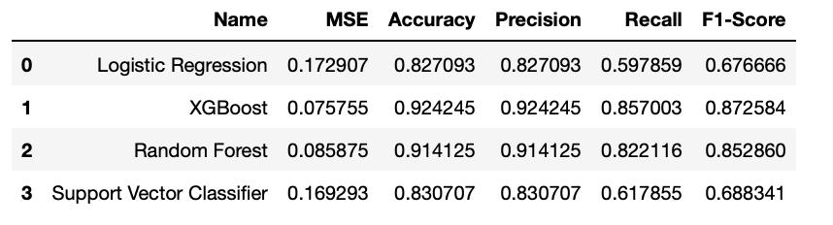
Performance from K fold cross validation

Slide 16


Model Analysis
Accuracy of the baseline model is 82.44% and MSE is 17.56%
Best choice: XGBoost and Random Forest
While Random Forest is easier to run and gives feature importance, XGBoost is more accurate

Slide 17
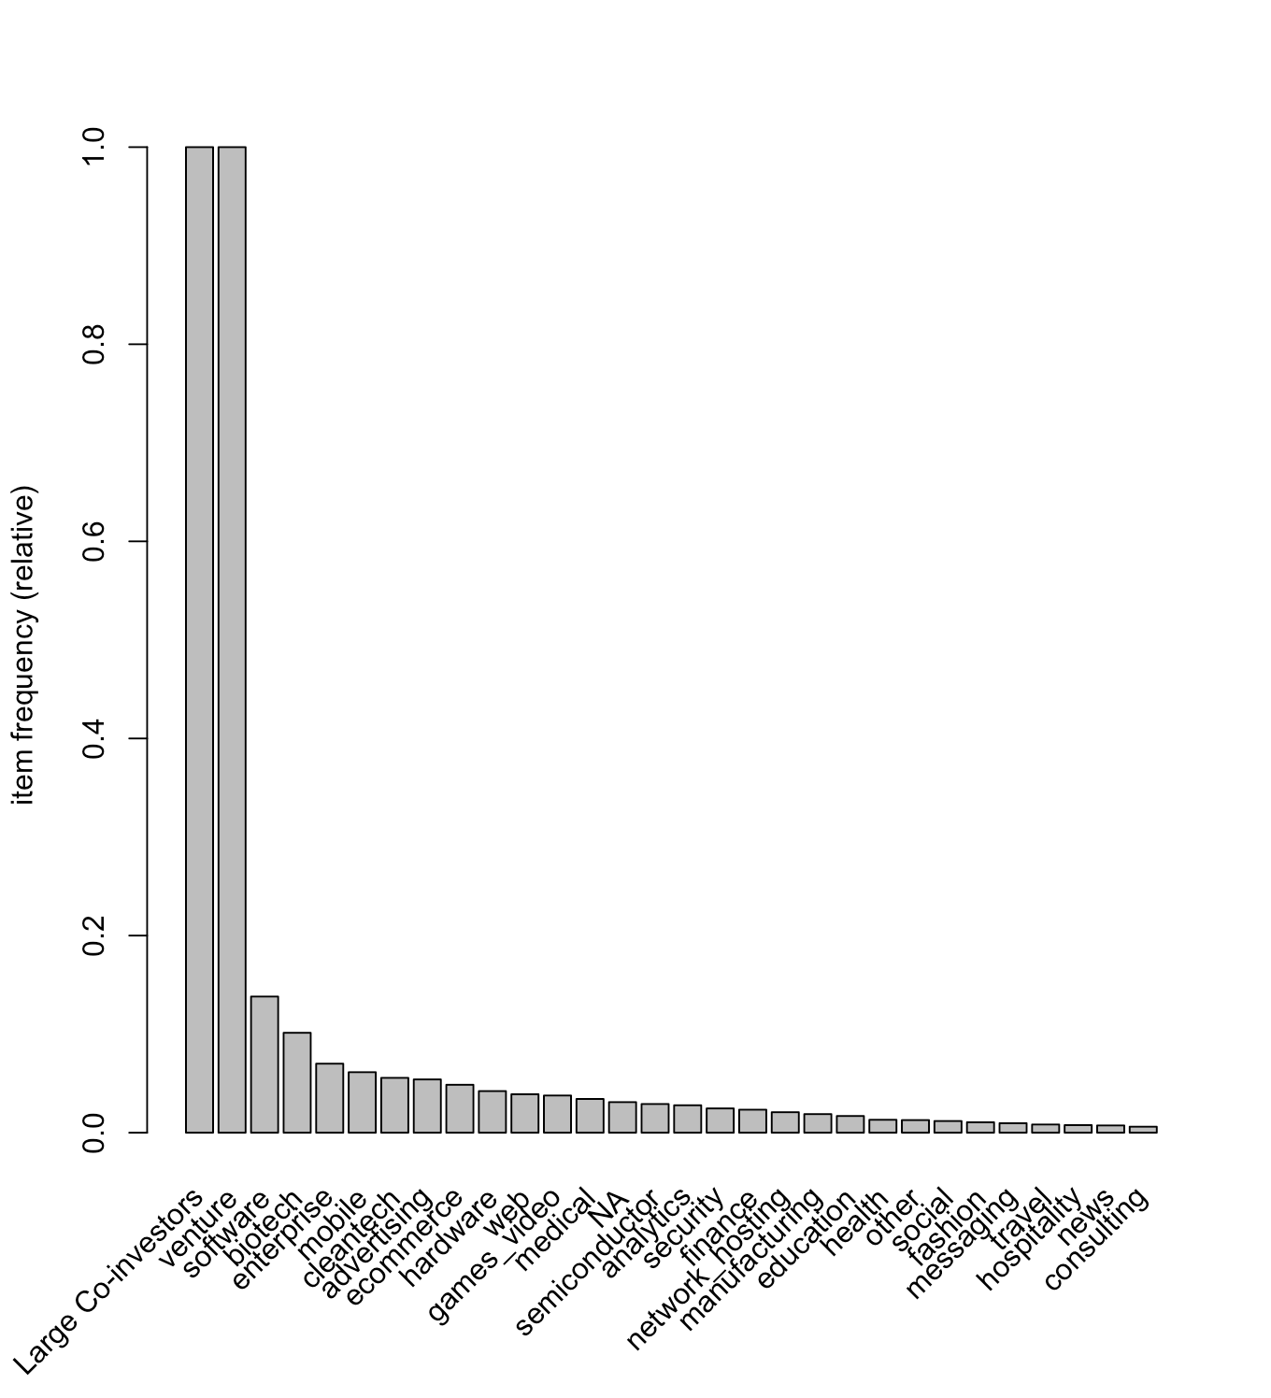
Market Basket Analysis
An algorithm to detect association rules (which features occurred together for a successful startup) and get feature likelihood, to understand to what extent the factors occur simultaneously for a VC portfolio.
Some investing features are quite common across VC portfolios. For instance, Large Co-investors are present in more than 80% of portfolios.

Slide 18
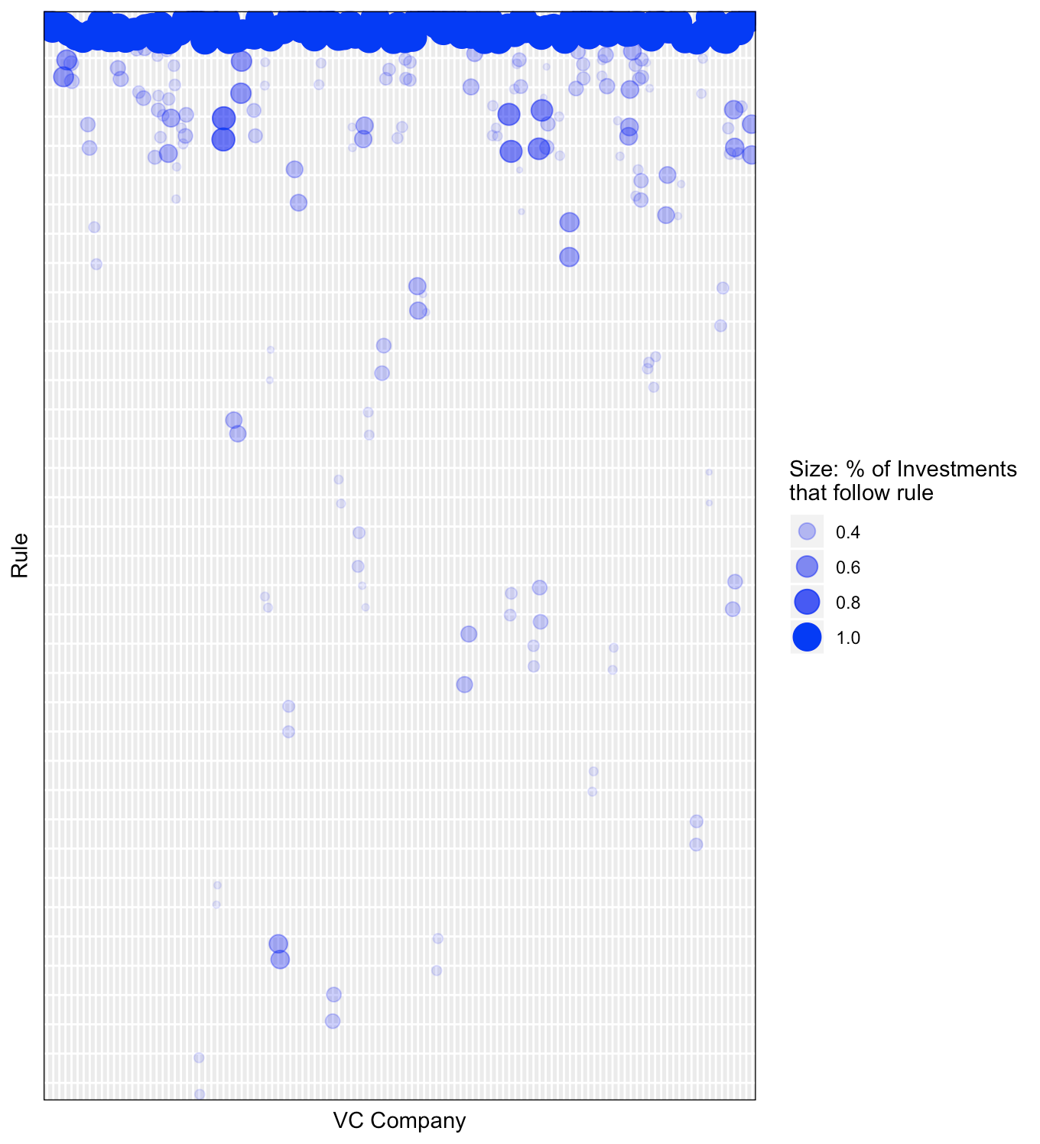
Rule usage per VC investor
The vertical axis contains each rule, whereas the horizontal axis contains each VC firm in the dataset. The circles’ width represents the percentage of the company’s portfolio that followed the corresponding rule

Slide 19
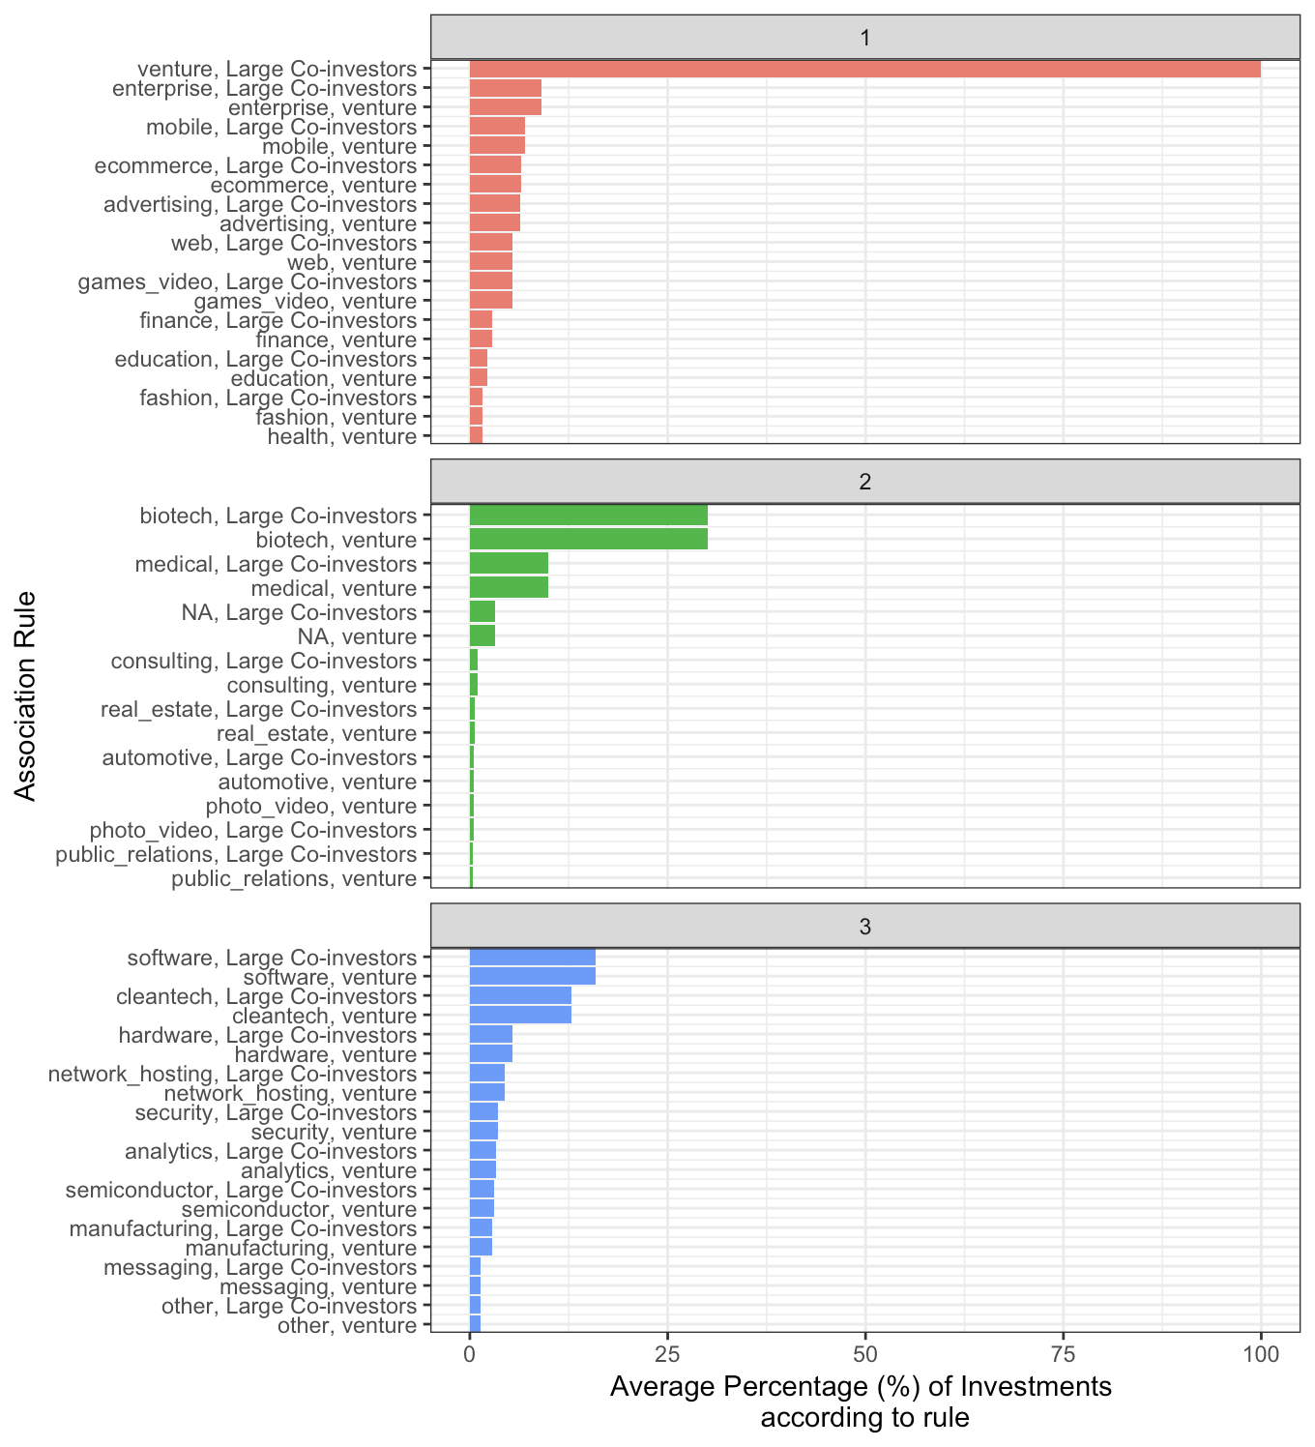
Hierarchical Clustering
Uniqueness of Clusters
For each rule which clusters have the highest average percentage of use (used two-sample test of proportions to filter only the rules that are significantly more preponderant in each cluster)

Slide 20
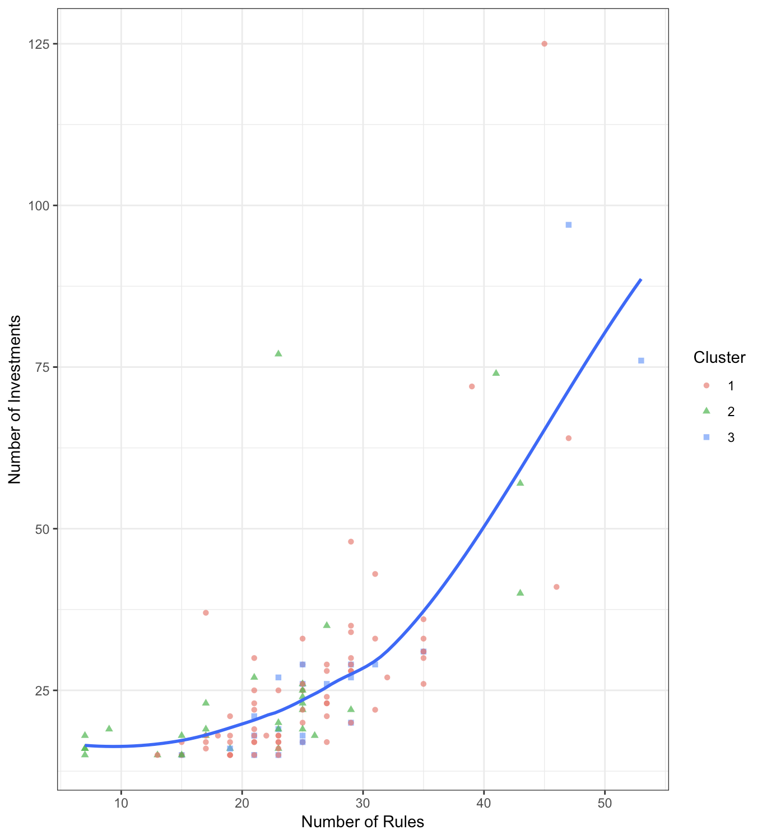
Portfolio Diversification
The largest VC firms in terms of the number of investments used the highest number of different rules which suggests portfolio diversification
Most of the largest VC firms were classified in cluster 3, which provides insight into the role of these firms in financing late stage rounds and software companies.

Slide 21
Insights
Even though the number of founder with business degrees is higher, we were able to deduce that the correlation between a founder succeeding if he has a computer science background is higher with good confidence. This can be due to the growing digital/software/data related startups
There is a good chance of a founder succeeding if his alma mater is an Ivy-League/Top-School contrary to the popular belief of being a dropout. We hypothesize this can be true given the great alum network or maybe just the nature of the network a founder is exposed to in an Ivy league
Number of founded organisations is negatively correlated which can be attributed to distraction
More number of founders is negatively correlated to success. This is consistent with the idea: too many views (people) result into poor decisions
Startups with highest number of investments are focussed at portfolio diversification as observed in our market basket analysis
Most of the largest VC firms finance late stage rounds and tech companies. So more and more tech startups are blooming and most new start-ups are in the tech category

Slide 22
Thank You

